Slide 1

House Price Prediction
HPP
Presented by:
Vivek Augustine

Slide 2

Problem Statement
A house value is simply more than location and square footage. Like the features that make up a person, an educated party would want to know all aspects that give a house its value. For example, you want to sell a house and you don’t know the price which you may expect — it can’t be too low or too high. To find house price you usually try to find similar properties in your neighborhood and based on gathered data you will try to assess your house price.

Slide 3
Objective: Take advantage of all of the feature variables available below, use it to analyze and predict house prices.
CID: A NOTATION FOR A HOUSE
DAYHOURS: DATE HOUSE WAS SOLD
PRICE: PRICE IS PREDICTION TARGET
ROOM_BED: NUMBER OF BEDROOMS/HOUSE
ROOM_BATH: NUMBER OF BATHROOMS/BEDROOMS
LIVING_MEASURE: SQUARE FOOTAGE OF THE HOME
LOT_MEASURE: QUARE FOOTAGE OF THE LOT
CEIL: TOTAL FLOORS (LEVELS) IN HOUSE
COAST: HOUSE WHICH HAS A VIEW TO A WATERFRONT
SIGHT: HAS BEEN VIEWED
CONDITION: HOW GOOD THE CONDITION IS (OVERALL)
QUALITY: GRADE GIVEN TO THE HOUSING UNIT, BASED ON GRADING SYSTEM
CEIL_MEASURE: SQUARE FOOTAGE OF HOUSE APART FROM BASEMENT
BASEMENT_MEASURE: SQUARE FOOTAGE OF THE BASEMENT
YR_BUILT: BUILT YEAR
YR_RENOVATED: YEAR WHEN HOUSE WAS RENOVATED
ZIPCODE: ZIP
LAT: LATITUDE COORDINATE
LONG: LONGITUDE COORDINATE
LIVING_MEASURE15: LIVING ROOM AREA IN 2015(IMPLIES-- SOME RENOVATIONS) THIS MIGHT OR MIGHT NOT HAVE AFFECTED THE LOTSIZE AREA
LOT_MEASURE15: LOTSIZE AREA IN 2015(IMPLIES-- SOME RENOVATIONS)
FURNISHED: BASED ON THE QUALITY OF ROOM
TOTAL_AREA: MEASURE OF BOTH LIVING AND LOT

Slide 4
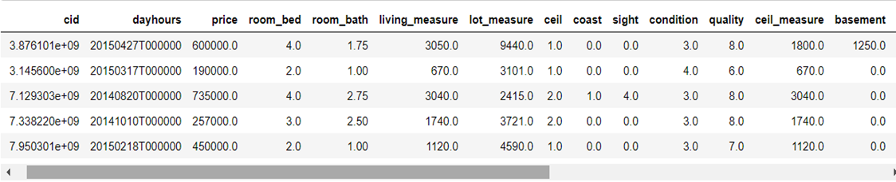
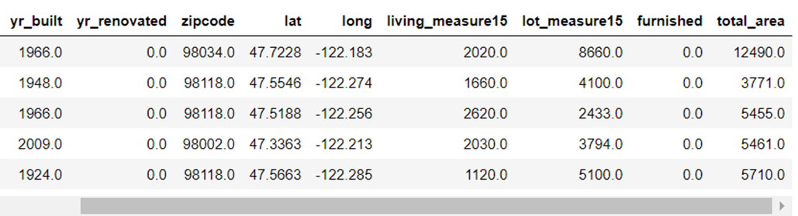
Table :

Slide 5
Shape of Table & Info
SHAPE :
(21613, 23)
INFO:
# Column Non-Null Count Dtype
0 dayhours 21613 non-null object
1 price 21613 non-null float64
2 room_bed 21505 non-null float64
3 room_bath 21505 non-null float64
4 living_measure 21596 non-null float64
5 lot_measure 21571 non-null float64
6 ceil 21571 non-null object
7 coast 21612 non-null object
8 sight 21556 non-null float64
9 condition 21556 non-null object
10 quality 21612 non-null float64
11 ceil_measure 21612 non-null float64
12 basement 21612 non-null float64
13 yr_built 21612 non-null object
14 yr_renovated 21613 non-null float64
15 zipcode 21613 non-null float64
16 lat 21613 non-null float64
17 long 21613 non-null object
18 living_measure15 21447 non-null float64
19 lot_measure15 21584 non-null float64
20 furnished 21584 non-null float64
21 total_area 21584 non-null object

Slide 6
Process
1. In table we can see there are Null values present in our data.
2.We can also see there are “NaN” and “$” Sign present in our data.
3.Firstly we removed the “NaN” and “$” Sign values from our data.
4.Then for the missing Values, we Used “KNNImputer”, so that we can treat those missing values.
5.After, Treating and Removing Unwanted Data the shape of our data is 21613 Rows and 22 Columns.
6. Through the help of Boxplot & Histogram we can see which variables have outliers in them and then remove those outliers with the help of IQR method. So, here we can see that 5 variables have outliers in them,“room_bed”, “living_measure”, “lot_measure”, “ceil_measure”, “basement”.
7.Now, we will be checking for outliers in our data, if there is any outlier in our data we can either cap the values of the data points or can remove the data points from our data. Shape after removing Outliers from our data 18289 Rows & 22 Columns.

Slide 7
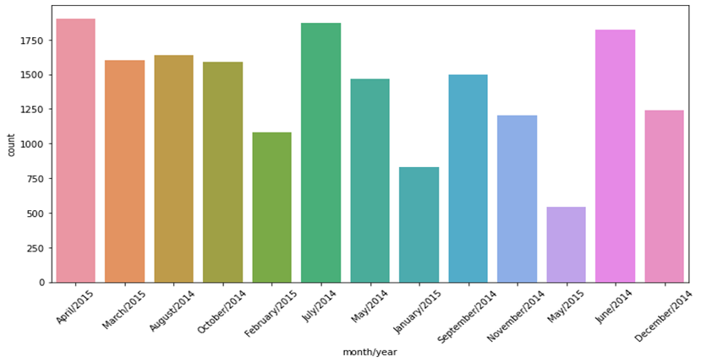
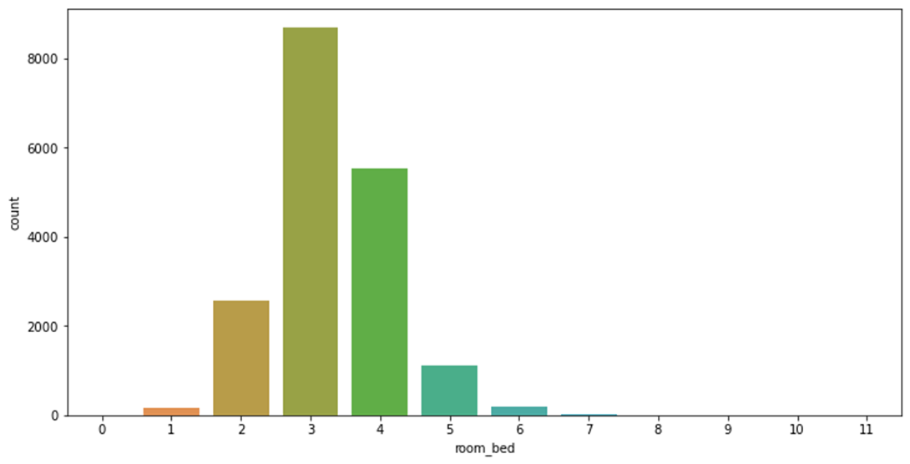
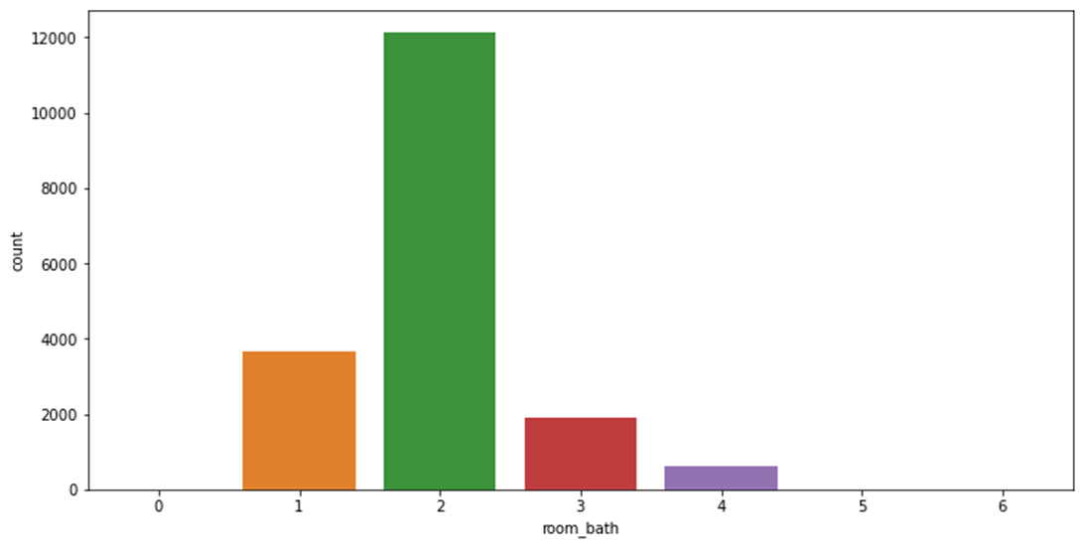
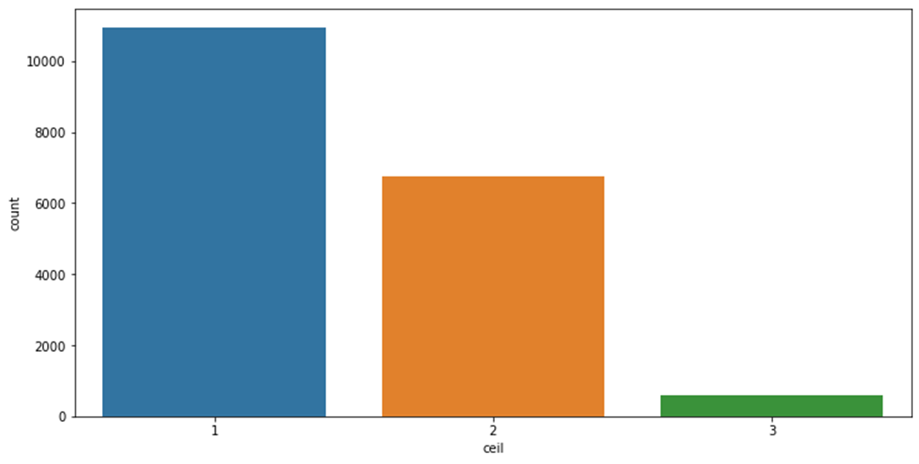
Analysis of Variables

Slide 8
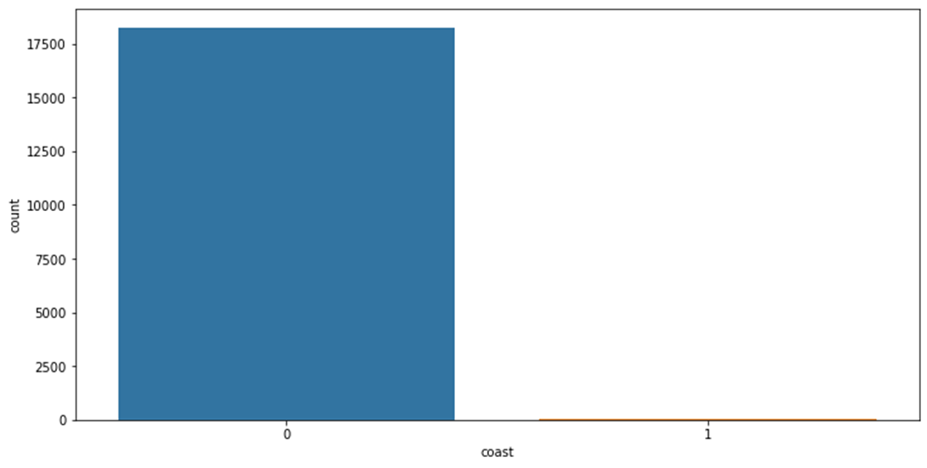
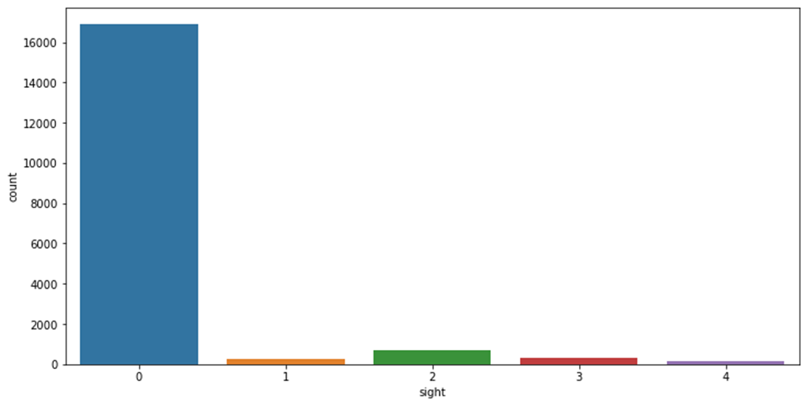
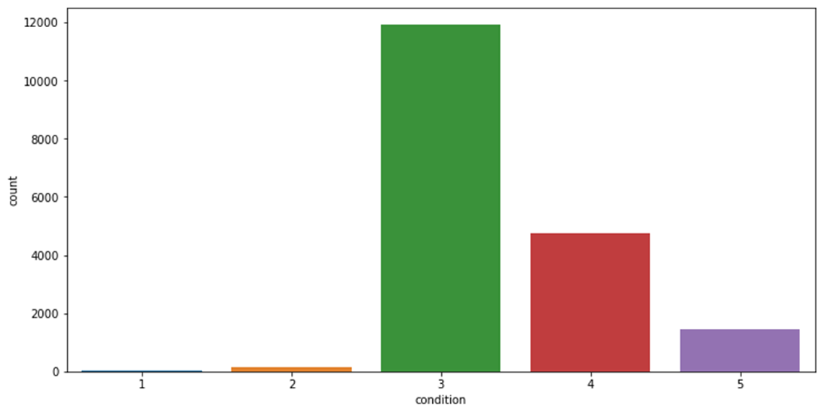
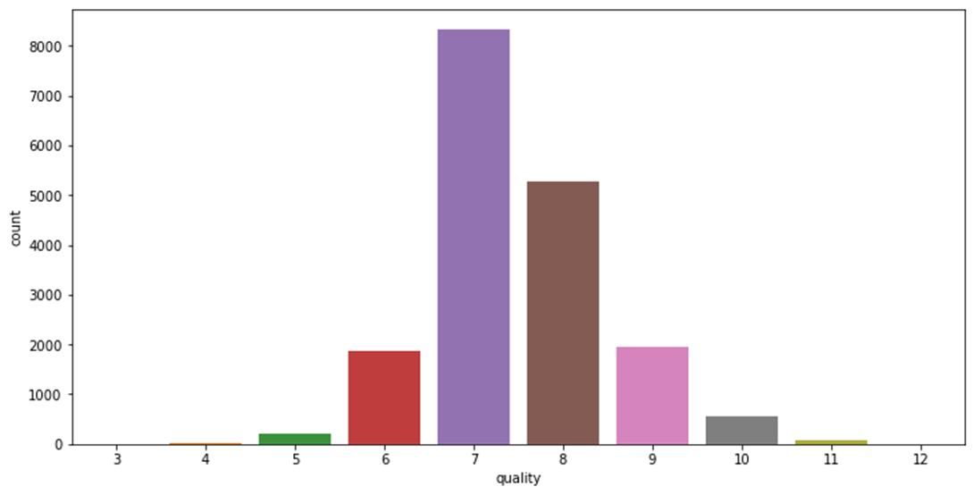
Analysis

Slide 9
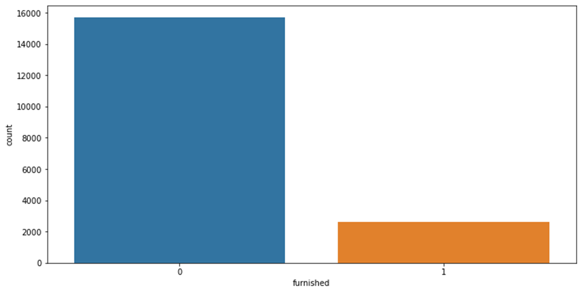
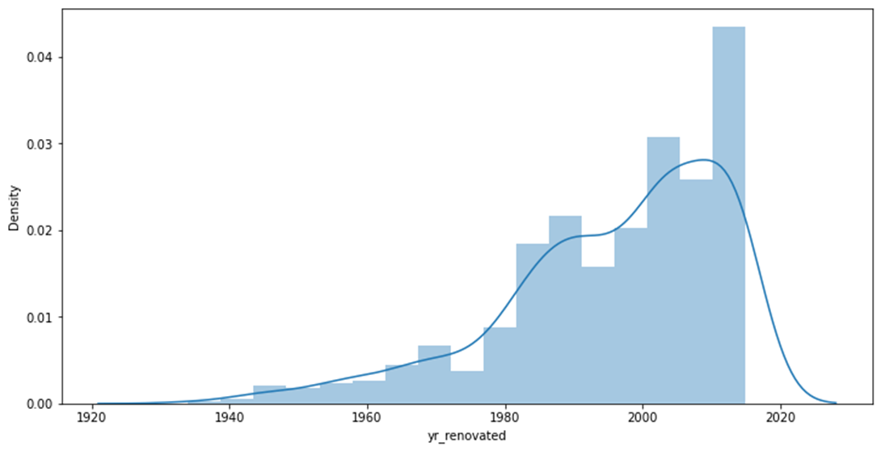
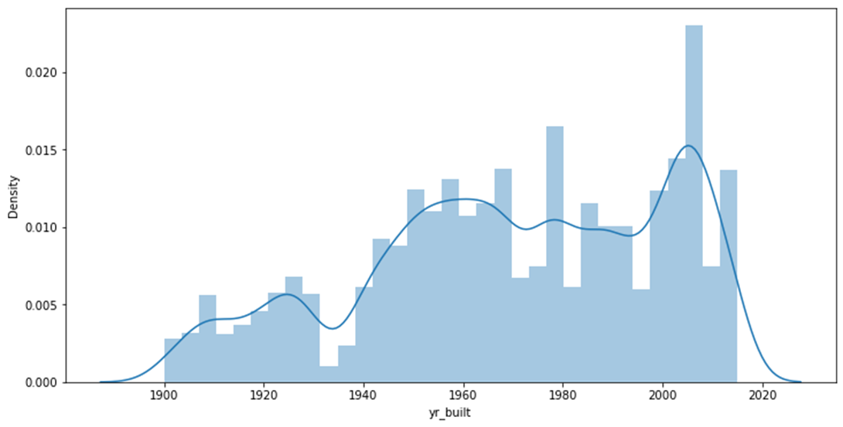
Analysis
1. From the above, we can conclude that in april 2015 and june and july of 2014 most houses are sold. (2). Most of the houses have 3 or 4 bedrooms.(3). Majority of the houses have 2 bathroom’s followed by 1 & 3.(4). Most houses have 1 and 2 floors (5). Most houses don't have waterfront view, very few are waterfront.(6). Most sights have not been viewed.(7). Overall most houses are rated as 3 and above for its condition overall.(8). Most of the housing unit have been given grade 7 followed by 8 & 9.(9). The built year of the properties range from 1900 to 2014 and we can see upward trend with time.(10). There is an upward trend in renovation's continuing from 1980.(11). Most properties are not furnished.

Slide 10
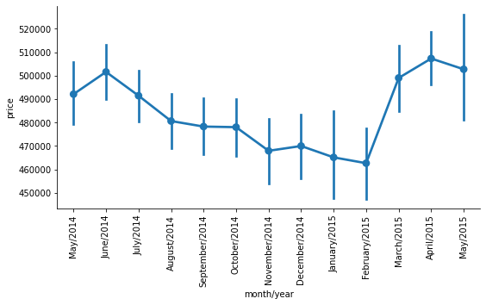
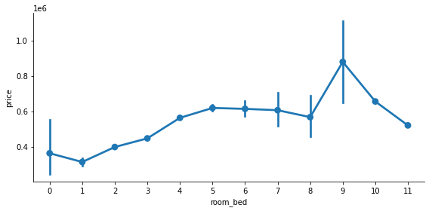
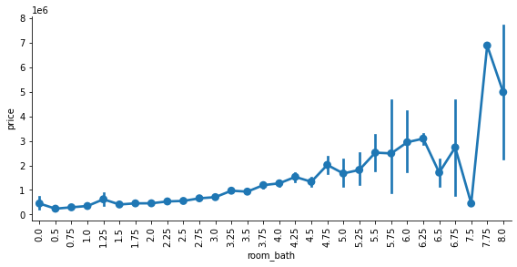
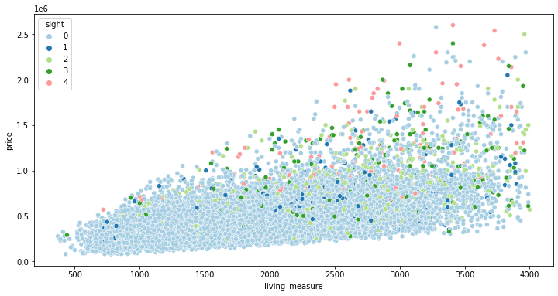
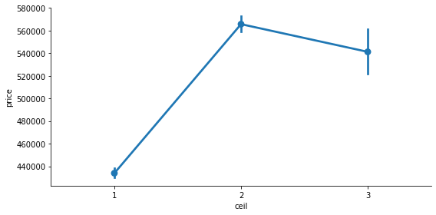
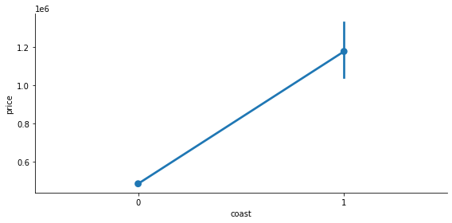
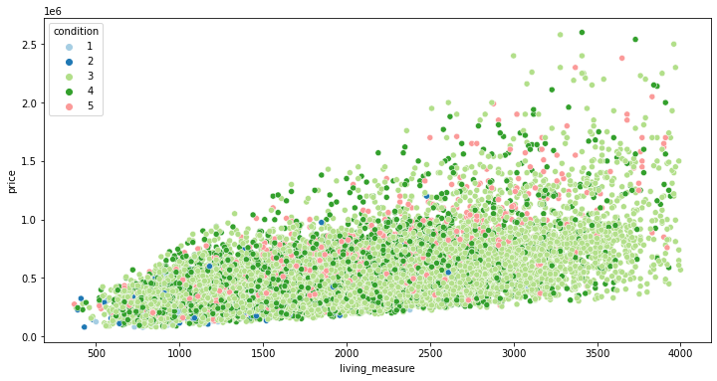
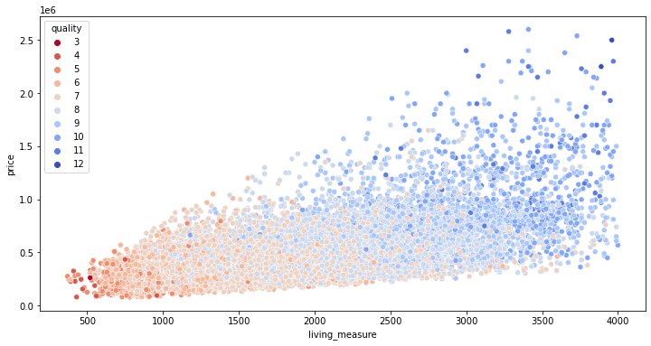
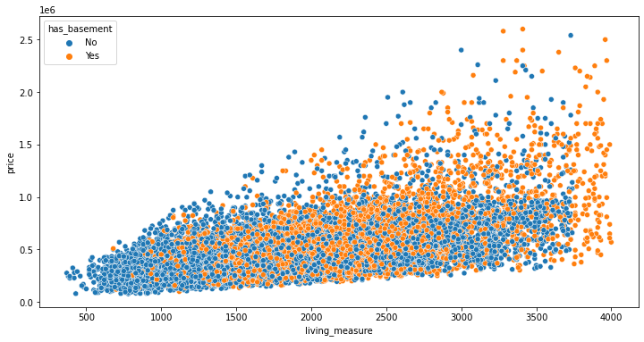
Analysis

Slide 11
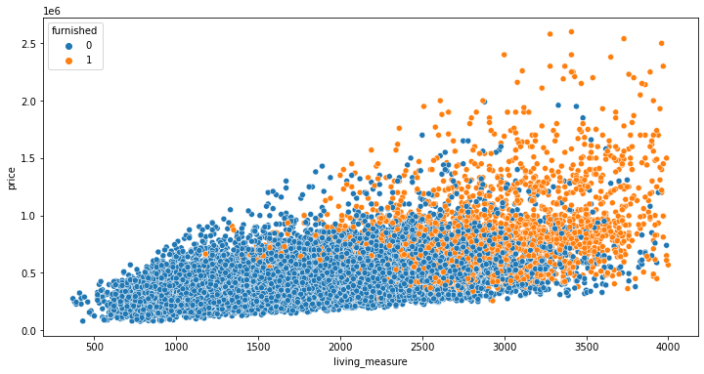
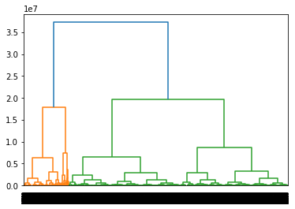
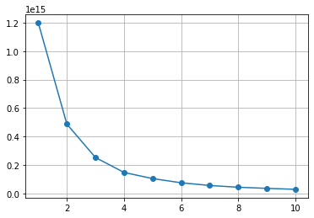
Analysis
The mean price of the houses tend to be high during March,April, May as compared to that of September, October, November,December period.(2) There is clear increasing trend in price with room_bed.(3) Overall mean and median price increares with increasing room_bath there is upward trend in price with increase in room_bath.(4) Initially the price is increasing and after that we can see a slight fall in price as it goes further.(5) The house properties with water_front tend to have higher price compared to that of non-water_front properties.(6) Viewed in relation with price and living_measure Costlier houses with large living area are sighted more. The above graph also justify that: Properties with higher price have more no.of sights compared to that of houses with lower price.(7) Viewed in relation with price and living_measure. Most houses are rated as 3 or more. So we found out that smaller houses are in better condition and better condition houses are having higher prices.(8) Viewed in relation with price and living_measure. Most houses are graded as 6 or more.(9) houses having basement have higher price & living measure.(10) Furnished has higher price value and has greater living_measure Furnished houses have higher price than that of the Non-furnished houses.
Heirarchical Clustering - Here, we can clearly see that hierarchical cluster method shows us 3 group of cluster's. The 1st Group belong's to the highest price range group the 3rd one belongs to the middle price range group & 2nd belongs to the lowest price range group. The group 1 posses 3108 propertise,group 2 with 7718 propertise & group 3 with 7463 propertise. As per this we can come to a decision that most of the propertise falls in lowest price group then the middle one followed by highest price group.
KNN Clustering - Here, we can see that 3 groups are formed first is group 0 with 6268 propertise then group 1 with 11275 propertise followed by group 2 with 746 propertise from this we can see that most of the propertise falls in group 1 followed by group 0 & group 2. Group 1 have a price range which comes in between group 0 & 2 whereas group 0 have maximum price range & group 2 have the lowest price range.So, it will be good to invest in those properties which falls in group 1.

Slide 12
MODELS
TRAIN DATA
Method | Train | RMSE | MSE | MAE
RF_Train | 0.947336 | 59288.9026 | 3.52E+09 | 41273.5842
BGG_Train | 0.926768 | 69914.61 | 4.89E+09 | 45614.9586
SVR_Train | 0.998463 | 10129.1641 | 1.03E+08 | 180137.557
NB_Train | 0.999086 | 7811.55735 | 6.10E+07 | 137477.887
KNN_Train | 0.999987 | 920.225588 | 8.47E+05 | 972.428995
LogisticReg_Train | 0.998886 | 8624.40989 | 7.44E+07 | 217180.535
LinearReg_Model_Train | 0.575639 | 168300.179 | 2.83E+10 | 121310.245
LDA_model_Train | 0.998662 | 9449.48865 | 8.93E+07 | 138367.521
DT_Train | 0.998478 | 10078.4034 | 1.02E+08 | 972.428995
GB_Train | 0.66681 | 149129.119 | 2.22E+10 | 109406.274
TEST DATA
Method | Test | RMSE | MSE | MAE
RF_Test | 0.63507 | 151162.751 | 2.29E+10 | 108565.917
BGG_Test | 0.601878 | 157887.574 | 2.49E+10 | 113066.152
SVR_Test | 0.998643 | 9218.40979 | 8.50E+07 | 178079.348
NB_Test | 0.998267 | 10417.9145 | 1.09E+08 | 165337.613
KNN_Test | 0.998556 | 9509.66391 | 9.04E+07 | 168178.955
LogisticReg_Test | 0.99913 | 7379.5698 | 5.45E+07 | 214311.377
LinearReg_Model_Test | 0.560861 | 165821.547 | 2.75E+10 | 120719.888
LDA_model_Test | 0.998278 | 10383.3483 | 1.08E+08 | 154302.666
DT_Test | 0.286495 | 211367.695 | 4.47E+10 | 146157.44
GB_Test | 0.620826 | 154084.641 | 2.37E+10 | 112120.464
MODELS AFTER Hyperparameter tuning using GridsearchCV
TRAIN DATA
Method | Train | RMSE | MSE | MAE
LinearReg_Model_Train | 0.09764 | 245418.076 | 6.02E+10 | 181317.885
BGG_Train | 0.93002 | 68345.1012 | 4.67E+09 | 47556.3177
RF_Train | 0.99998 | 1208.24089 | 1.46E+06 | 1079.7134
NB_Train | 0.99968 | 4597.86514 | 2.11E+07 | 406970.756
KNN_Train | 0.99999 | 920.225588 | 8.47E+05 | 972.428995
LDA_model_Train | 0.99873 | 9201.09674 | 8.47E+07 | 139243.646
DT_Train | 0.99894 | 8427.31598 | 7.10E+07 | 145367.596
GB_Train | 0.58593 | 166247.552 | 2.76E+10 | 121298.552
TEST DATA
Method | Test | RMSE | MSE | MAE
LinearReg_Model_Test | 0.06046 | 242548.55 | 5.88E+10 | 180023.915
BGG_Test | 0.59711 | 158830.856 | 2.52E+10 | 115580.765
RF_Test | 0.99783 | 11647.6748 | 1.36E+08 | 142296.091
NB_Test | 0.99985 | 3079.37414 | 9.48E+06 | 403900.257
KNN_Test | 0.99852 | 9617.52476 | 9.25E+07 | 168105.524
LDA_model_Test | 0.99839 | 10057.5157 | 1.01E+08 | 157340.897
DT_Test | 0.99825 | 10458.5792 | 1.09E+08 | 153568.321
GB_Test | 0.56701 | 164655.705 | 2.71E+10 | 121789.022

Slide 13
Insights & Recommendation
Here, we can see that properties which are falling in one of the 3 categories in both the methods which we used to make clusters from observing that we can predict the price of those properties based on that result also we can probably take a hunch of the price of the property if its going to increase in the near future based on this current data.
Here, I have used various models for predictions. So, that we can get accuracy on our price prediction through the Train & Test values of our models , we can also choose one model if we have a preference to choose by RMSE values.
We also have values of MAE & MSE which helps us decide which model to choose. Mean absolute error (MAE) is a measure of errors between paired observations expressing the same phenomenon & the Mean squared error (MSE) of an estimator measures the average of the squares of the errors that is, the average squared difference between the estimated values and the actual value.
I prefer to go with Train and Test value so for that reason the most suited model would be the RF Model because other models are either over fitted or have low value and if see from the perspective of RMSE value If the noise is small, as estimated by RMSE, this generally means our model is good at predicting our observed data, and if RMSE is large, this generally means our model is failing to account for important features underlying our data. So, These models will help us analyze the most appropriate way to what direction we should go it will help us determine correct prices and areas and all of the variables which are present in our data.
so, here in 2ns Section of Table which we got by Tuning our models. We can see that most of the model are over fitted. So, here I would choose BGG Model as its not over fitted and can provide good assistance while applying this model. So, yeah in all I would prefer the models in which I have not used hyper parameters that is RF model its the most optimum model and better suited for the business and the direction it want to go in.
So, I would suggest you if you want to sell your house please keep in mind the Value which we generated from cluster. I'm going to choose the price around 350,000 $ which is an average price but if your home is in a good location and have more no of bedrooms & bathroom and is fully furnished and have a coastal view you can charge around 550,000$ - 600,000$.

Slide 14
Thank You.
HPP
Augustine Vivek
+918469216988
vivekaugustine1997@gmail.com
www.GreatLearning.com

